Slide 1
Mastering R – Advanced Data Science and Statistical Analysis – Lecture #2 Reproducible research with renv and github Alen Lovric and Billy Langlet

Slide 2



Today’s Lecture
Reproducible research with renv and github
Why renv?
Standard workflow and example in Rstudio
Why Git? What is Git? What is Github?
Git and Rstudio
Integration of renv and Git

Slide 3
Why renv?
Isolated: Each project maintains its own private package library, preventing the installation or update of packages for one project from affecting others.
Portable: Projects can be effortlessly transferred between different computers and platforms with the help of renv, which simplifies the process of installing required packages.
Reproducible: renv records precise package versions, guaranteeing the same versions between collaborators

Slide 4
Libraries and Repositories
Library is a directory containing installed packages.
To see your current libraries use .libPaths(), and to see which packages are available in each library use lapply(.libPaths(), list.files).
For outdated packages use View(old.packages()).
Repository is a source of packages, usually somewhere on the Internet.
CRAN
Bioconductor
Posit Public Package Manager
R Universe
GithHub
install.packages(); getOption("repos"); setRepositories()
BiocManager::install()
renv::install()
pak::pkg_install()

Slide 5
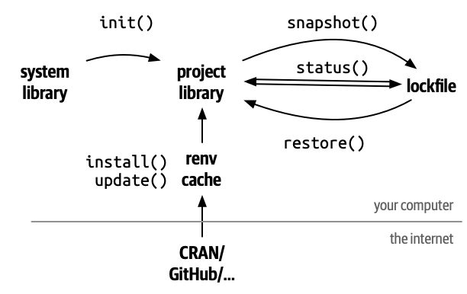
General workflow with renv
renv::init() - initialize a new local environment.
renv::snapshot() - save the state of the project library to the lockfile.
renv.lock (lockfile) - records metadata about every package in your local environment that can be re-installed (e.g. on a new machine).
renv::restore() - reverts to the previous state as encoded in the lockfile.
renv::install() - install packages from GitHub, Bioconductor, CRAN, and more.
renv::update() - update to latest versions of all dependencies.
renv::status() - reports inconsistencies between lockfile, library, and dependencies.
Adopted from: https://rstudio.github.io/renv/articles/renv.html

Slide 6
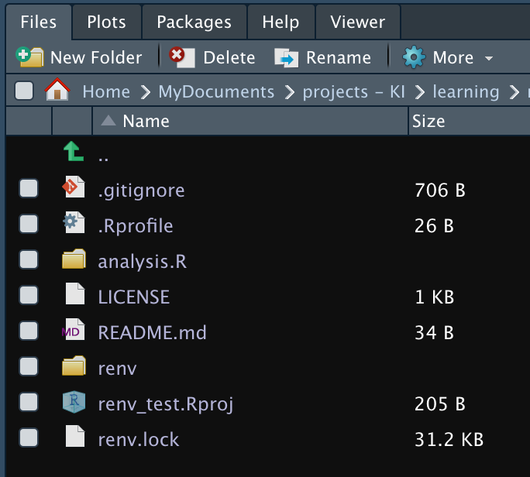
Getting started with renv
renv::init() - initialize a new local environment.
renv::snapshot() - save the state of the project library to the lockfile.
renv.lock (lockfile) - records metadata about every package in your local environment that can be re-installed (e.g. on a new machine).
renv::restore() - reverts to the previous state as encoded in the lockfile.
renv::install() - install packages from GitHub, Bioconductor, CRAN, and more.
renv::update() - update to latest versions of all dependencies.
renv::status() - reports inconsistencies between lockfile, library, and dependencies.

Slide 7
Getting started with renv
renv::init() - initialize a new local environment.
renv::snapshot() - save the state of the project library to the lockfile.
renv.lock (lockfile) - records metadata about every package in your local environment that can be re-installed (e.g. on a new machine).
renv::restore() - reverts to the previous state as encoded in the lockfile.
renv::install() - install packages from GitHub, Bioconductor, CRAN, and more.
renv::update() - update to latest versions of all dependencies.
renv::status() - reports inconsistencies between lockfile, library, and dependencies.
Adopted from: https://rstudio.github.io/renv/articles/renv.html

Slide 8
Installing and updating pckgs with renv
renv::init() - initialize a new local environment.
renv::snapshot() - save the state of the project library to the lockfile.
renv.lock (lockfile) - records metadata about every package in your local environment that can be re-installed (e.g. on a new machine).
renv::restore() - reverts to the previous state as encoded in the lockfile.
renv::install() - install packages from GitHub, Bioconductor, CRAN, and more.
renv::update() - update to latest versions of all dependencies.
renv::status() - reports inconsistencies between lockfile, library, and dependencies.
Adopted from: https://rstudio.github.io/renv/articles/renv.html

Slide 9
Caveats of renv
R version: renv tracks the R version but doesn't assist R version management. You might find tools like rig, rswitch and conda, as they make it easier to switch between multiple version of R on one computer.
Pandoc: rmarkdown heavily relies on pandoc but it's not bundled with the package. Restoring rmarkdown from the lockfile may not ensure identical rendering. For debugging refer to pandoc package.
Operating system, versions of system libraries, compiler versions: Docker is one popular solution for keeping stable machine image.

Slide 10
Uninstalling renv
renv isn’t the right fit for your project!!!
To deactivate renv in a project you can use 3 different solutions
Deactivate renv only for the current project
renv::deactivate() and renv::activate()
Completely remove renv from a project
renv::deactivate(clean = TRUE)
Stop using renv across all project and remove global infrastructure
root <- renv::paths$root()
unlink(root, recursive = TRUE)
utils::remove.packages("renv")

Slide 11

Summary and Discussion
Adopted from: https://www.deviantart.com/zungam80

Slide 12
Summary and Discussion
The Good
Isolated
Portable
Reproducible
Adopted from: https://www.deviantart.com/zungam80

Slide 13
Summary and Discussion
The Good
Isolated
Portable
Reproducible
The Bad and The Ugly
Learning curve?
Storage overhead?
Initialization time?
Dependency updates
Doesn’t support R version management
Adopted from: https://www.deviantart.com/zungam80

Slide 14
Break 😊

Slide 15

What, why, and how with Rmarkdown

Slide 16
What is RMarkdown?
Markup language
Text encoding system which specifies the structure and formatting of a document and the relationships among its parts.
HTML is commonly known markup languages which is used to structure and display content on the web. For example, we can use tags like <h1>, <p>, <a>, and <ul> to define headings, paragraphs, links, and lists.
Markdown
Lightweight markup language that provides a simple way to format text without complex syntax or tags.
It uses plain-text syntax (like # for H1, ## for H2, etc), so it can be easily read and written by anyone, and it can then be converted to more complex formats like HTML or PDF.
RMarkdown
Extension of Markdown that allows you to embed R code directly within a Markdown document. It combines the simplicity of Markdown with the power of R, making it ideal for creating dynamic reports that include both analysis and output (e.g., graphs, tables, summaries).

Slide 17
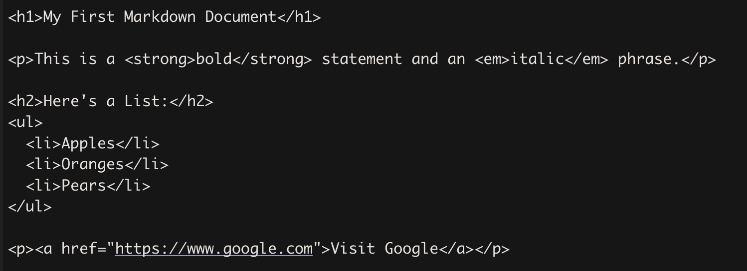
Markup (HTML)
Syntax: Uses HTML tags to define structure and style (e.g., <h1>, <p>, <ul>, <li>).
Formatting: Formatting (bold, italic) is controlled through tags like <strong> for bold and <em> for italics.
Lists: Ordered and unordered lists are created using <ol> and <ul> tags together with the list item element <li>.
Hyperlinks: Created using <a href="URL">.
HTML

Slide 18
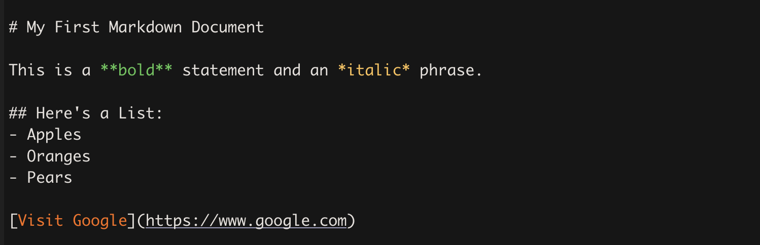
HTML
Markdown:
Syntax: Uses minimal syntax for formatting, making it easy to write and read.
Headings: Indicated with # symbols (like # for H1, ## for H2, etc.).
Text Styling: Uses simple symbols like *, ** for italics and bold.
Lists: Uses *, -, or + for unordered lists and numbers for ordered lists.
Links: Defined with square brackets for the link text, followed by the URL in parentheses.
Markdown

Slide 19
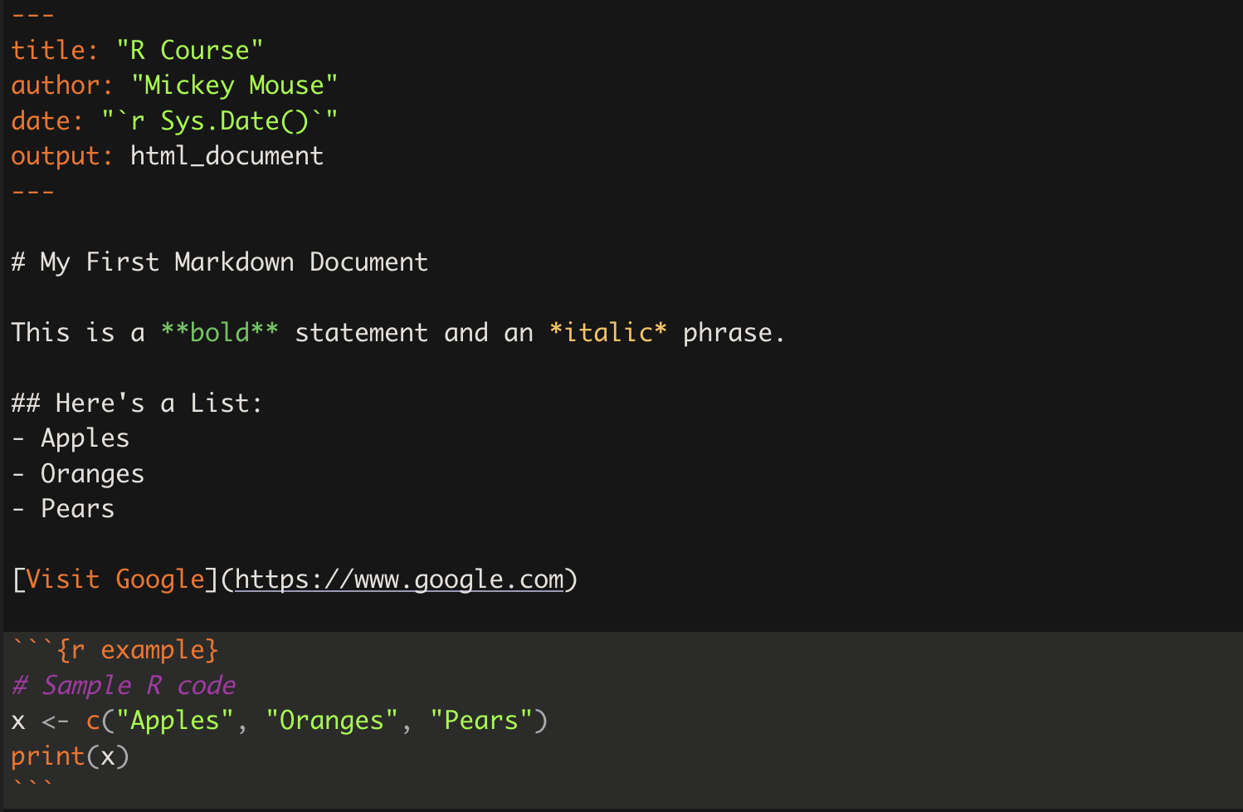
RMarkdown
RMarkdown
Metadata: Includes an "R" YAML header at the top (e.g., title, author, output) to set document properties.
Text Formatting: Inherits all Markdown features for formatting, lists, and links.
Code Chunks: Supports embedded code chunks within triple backticks and {r} for R code (e.g., ```{r example} ```), where r indicates the language, and example denotes the name of the chunk. Each chunk comes with several options controlling how the chunk is evaluated.

Slide 20
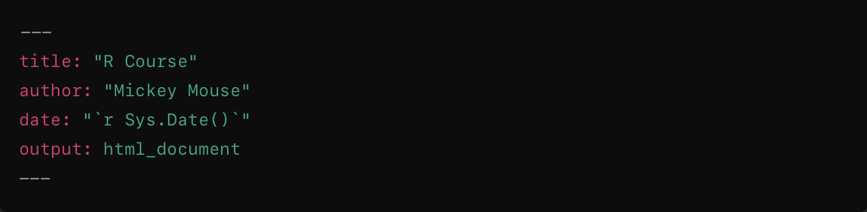
How to use RMarkdown?
YAML Block (---): This block at the beginning of the file is a header section in YAML format, defining metadata and document output options.
title:: Specifies the document's title, "R Course", which will be displayed at the top of the rendered document.
author:: Indicates the author’s name, "Mickey Mouse", typically displayed below the title.
date:: Uses inline R code (r Sys.Date()) to dynamically insert the current date each time the document is rendered.
output:: Specifies the output format, html_document, meaning this file will render as an HTML file.
ymal

Slide 21
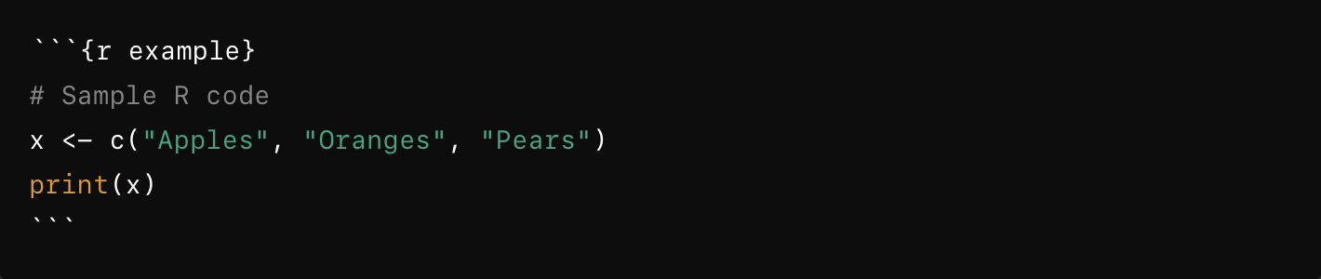
How to use RMarkdown?
Syntax:
Triple backticks ```: Denote the beginning and end of an R code chunk.
{r example}: Specifies that this is an R code chunk, with "example" as an optional label. The label can help organize and refer to code chunks, especially when displaying output or debugging.
Purpose: The R code chunk allows you to embed R code directly in the document, which will be executed when rendering the document. The code results are displayed alongside text.
R chunk

Slide 22
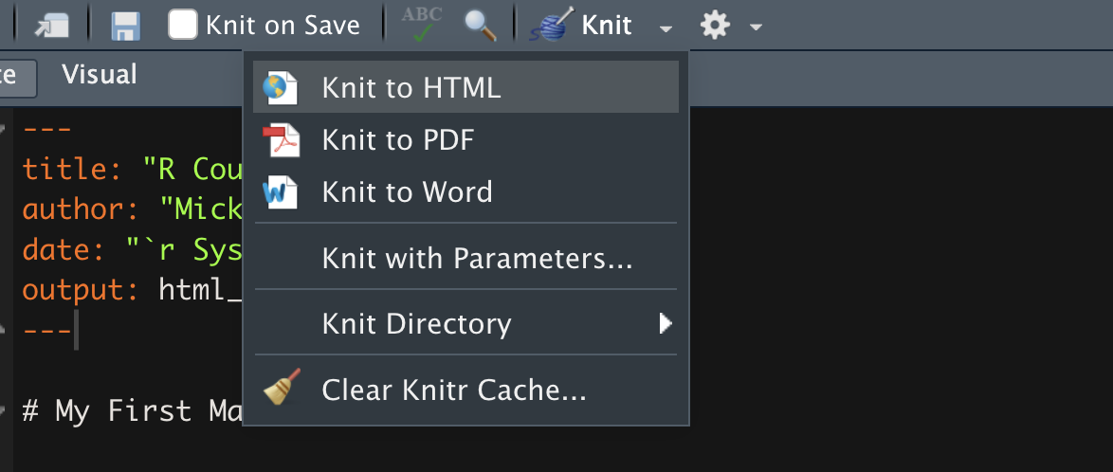
How to use RMarkdown?
Rendering
We can render/knit reports in several different ways:
Pressing the Knit button with or without parameters in RStudio
Running the R command render():
In the R console: rmarkdown::render("test_file.Rmd")
Running from the command line: R -e 'rmarkdown::render(”test_file.Rmd")'

Slide 23
Why use RMarkdown?
Notebooks: allow for a more interactive approach, where researchers can include code, narrative, and visualizations in a flowing document. Each chunk of code can be executed independently, making it easy to test ideas step-by-step.
Reports: focus on presenting a clean, structured summary of findings, methods, and visualizations, with code hidden or minimized to keep the report focused. Reports can include executive summaries, methods, and detailed results. Rendered in multiple formats HTML, PDF and Word.
Generalization: useful for workflows that need to be rerun on new data or under different assumptions, providing both reproducibility and efficiency.

Slide 24
Break 😊

Slide 25
What will we cover?
Introduction to Version Control
What is Git?
Basic Git Commands
What is GitHub?
Integration with R
Workflow in R
Q&A

Slide 26
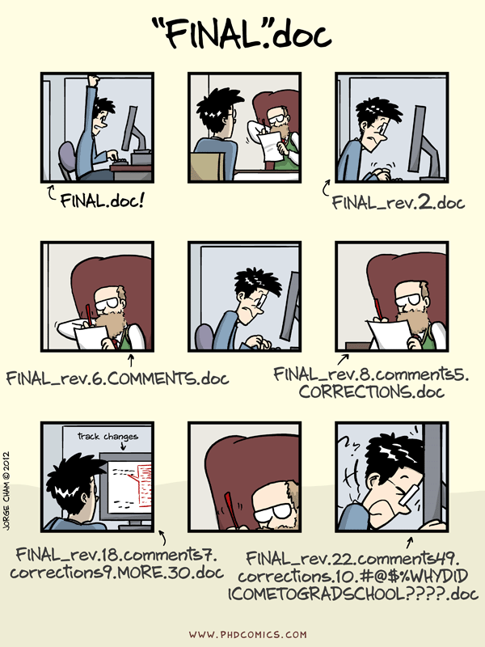
Version Control
Definition: Version control is like a time machine for your code, systematically tracking changes and enabling seamless collaboration.
Importance: In software and data science, version control is vital. It ensures organized coding, easy collaboration, and the ability to revert to stable versions.
Examples:
Project Stability: Easily revert to a stable version after experiments.
Team Collaboration: Multiple contributors work simultaneously without conflicts.
Adopted from: https://www.phdcomics.com

Slide 27
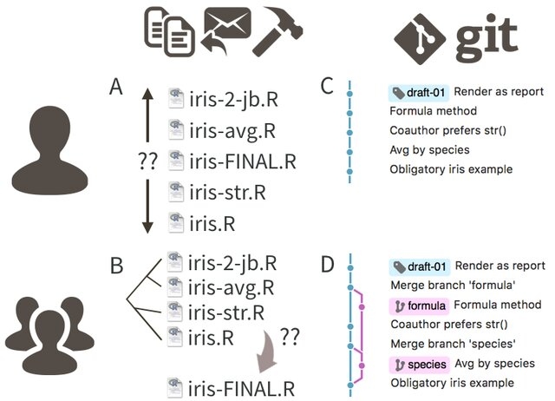
What is Git?
Definition
Git is a decentralized version control system.
Key Features:
Local Use: Git can be used locally on an individual's machine, allowing them to track changes, commit locally, and manage version history without the need for a centralized server.
Distributed Collaboration: Git also supports collaboration by allowing users to share changes with others, whether through a central repository (like on GitHub) or by directly sharing changes between their local repositories.
DOI: 10.7287/peerj.preprints.3159; License: CC BY 4.0

Slide 28
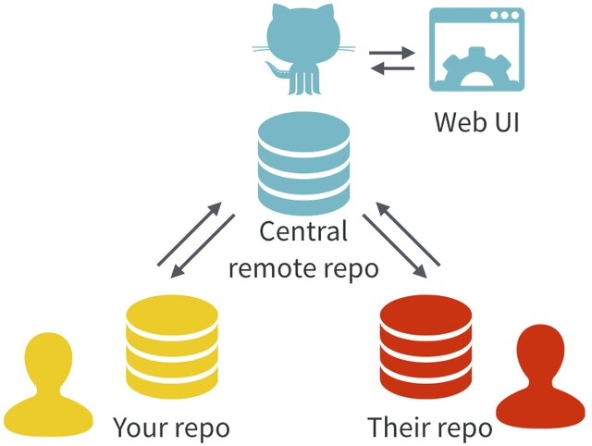
What is GitHub?
Git vs. GitHub
Git:
Version control tool
Command-line interface
GitHub:
Web-based platform
Hosts Git repositories
Provides collaboration features
GitHub's Role
Hub for developers
Millions of projects stored
Collaboration and project management
Key Features
Graphical interface
Issue tracking
Project management tools
DOI: 10.7287/peerj.preprints.3159; License: CC BY 4.0

Slide 29
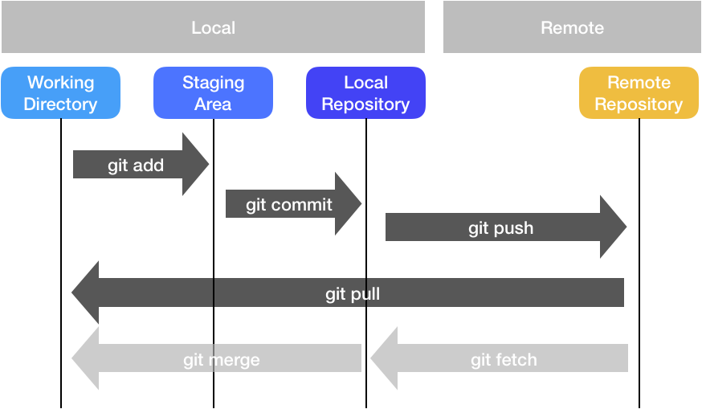
Git Commands
Building Blocks for managing your Git
git add: Add changes to the staging area.
git commit: Record changes to the repository.
git push: Add changes in the local git repository to the remote repository
git pull: Update local git repository from the corresponding remote git repository
git log: View commit history.
Adopted from: https://docs.ccv.brown.edu/oscar/managing-files/version-control

Slide 30


Integration with R
Install Git:
Download and install from git-scm.com.
Configure Git in RStudio:
Open RStudio.
Go to Tools > Global Options.
Set the path to the Git executable.
Create a GitHub Account:
Sign up at github.com.
Create R Project with Version Control:
In RStudio, go to File > New Project > Version Control > Git.
Enter GitHub repository URL.
Choose a project directory and click "Create Project."

Slide 31
Summary and Discussion
What is Git?
Open-source version control software.
Tracks and manages changes in code.
Allows viewing all previous versions of project code.
Why Git?
Version Tracking: See and manage project history.
Collaboration: Work simultaneously with others.
Backup and Recovery: Safeguard code and recover previous versions.
What and why GitHub?
Collaboration Platform:
Hosts Git repositories.
Popular for code collaboration.
Features:
Issue tracking, project management.
Integration with RStudio?
Streamlined Collaboration:
Easily collaborate on R projects.
Version Control in RStudio:
Track changes directly within RStudio.
Access GitHub Features:
Leverage GitHub's collaboration tools.

